Slide 1
Design and Simulation of a Novel HPGe-PEN-sAr System for Future Rare Event Experiments
Zhenyu Zhang
CDEX, Tsinghua Univ.

Slide 2
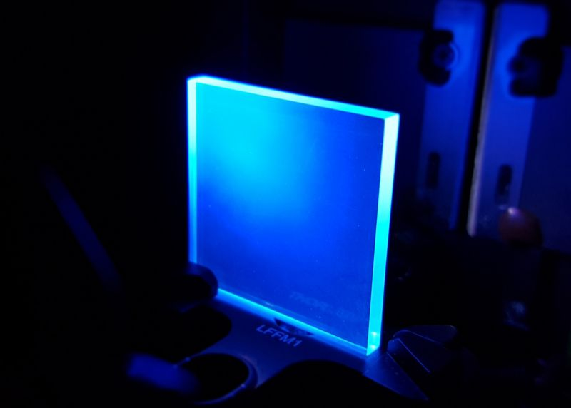
Motivations
LN₂ that provide low temperature environment in CJPL is clean, cheap but lacks the ability of active veto either.
Structural materials we use now cannot be used for active veto.
We are looking for a system that can support the array as well as provide active veto ability. And PEN material with solid argon seems like a very promising solution.
PEN and sAr provide veto ability with scintillation and PEN also works as structural material.
Polyethylene naphthalate(PEN):
A common plastic that has a high scintillation performance as well as enough strength to be a structural material.

Slide 3
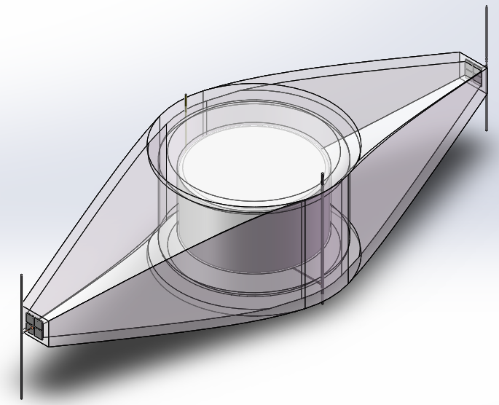
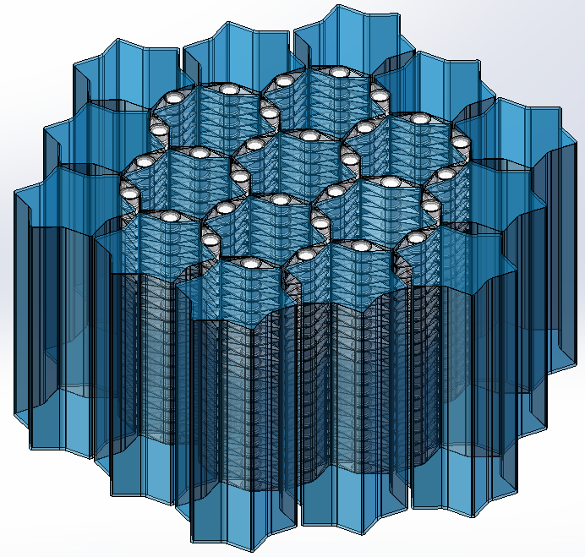
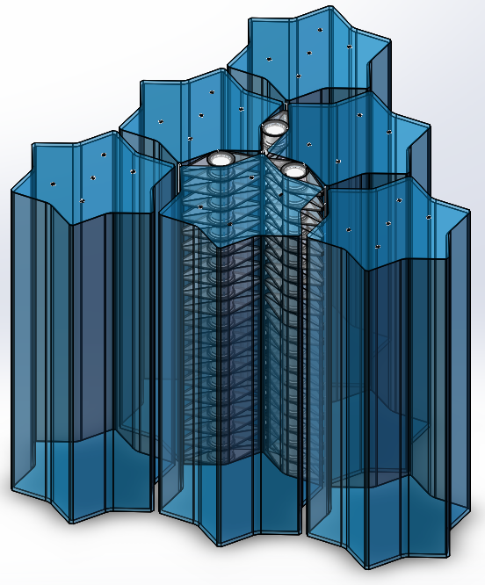
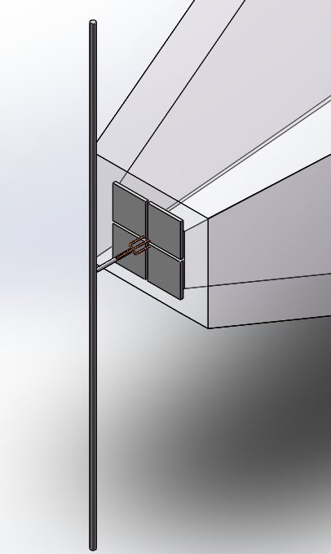
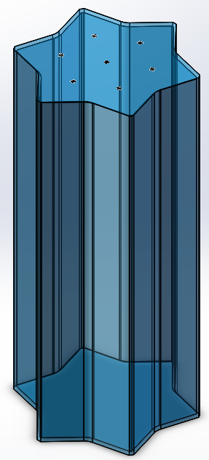
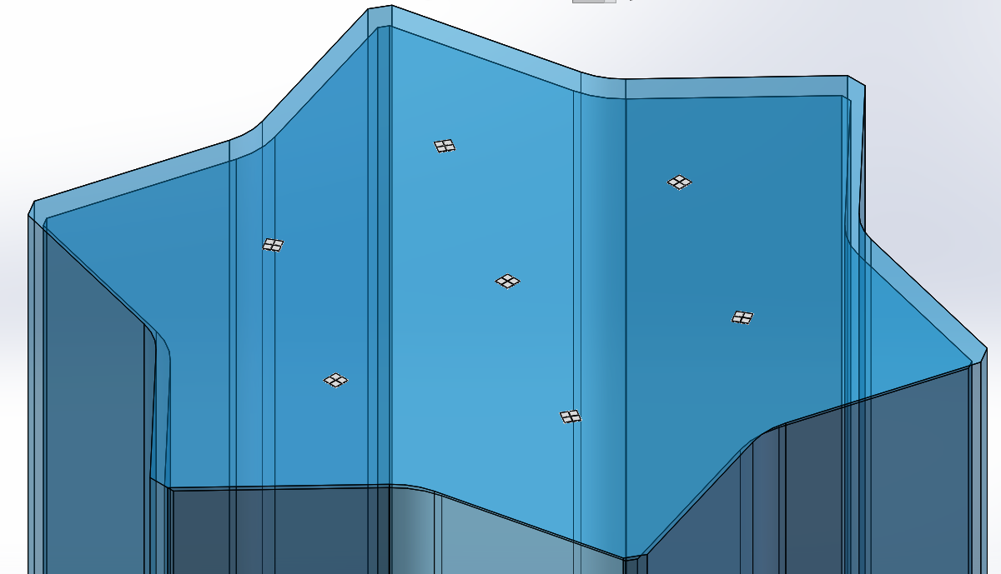
Modularized HPGe-PEN-sAr Composite System

Slide 4

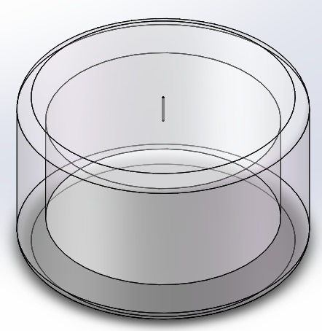
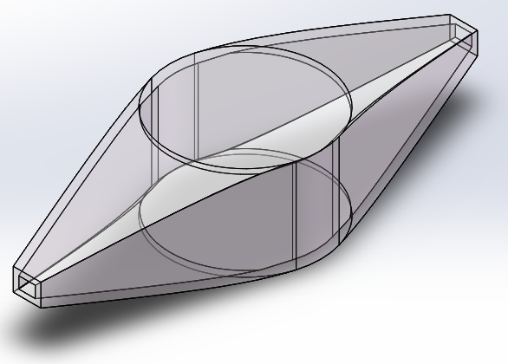
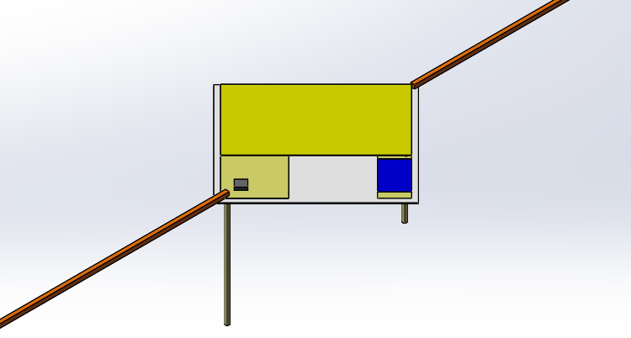
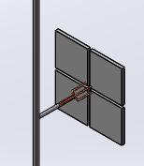
HPGe-PEN Unit
HPGe detector
Inner PEN shell
Outer PEN shell
Detector electronics
SiPM Readout array

Slide 5
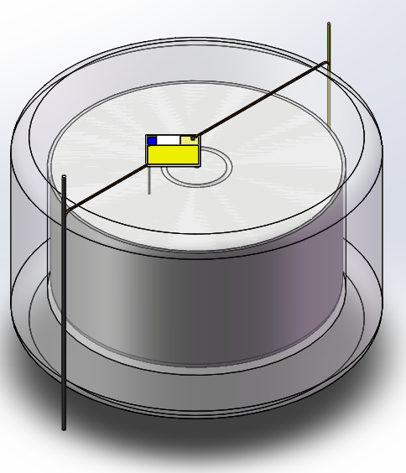
Inner PEN Shell
A 1-cm-thick cylinder shell that contains a BEGe detector.
The structure is preferred to be sealed from outside if the connection between two pins and PEN is good to reduce leakage current. If not, it can also be a open structure with liquid or gas of N₂ flows through it.
Electronics are preinstalled to the structure by clipping or moulding. No further installation with extra nails or bolts is needed.
The thickness can be cut down if strength is confirmed in further experiments.

Slide 6
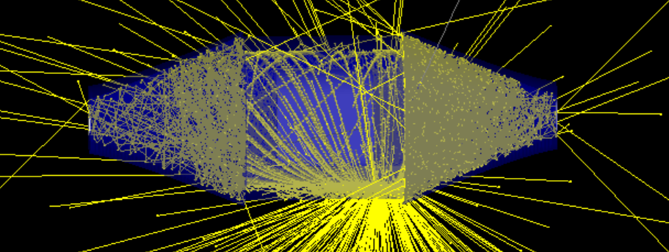
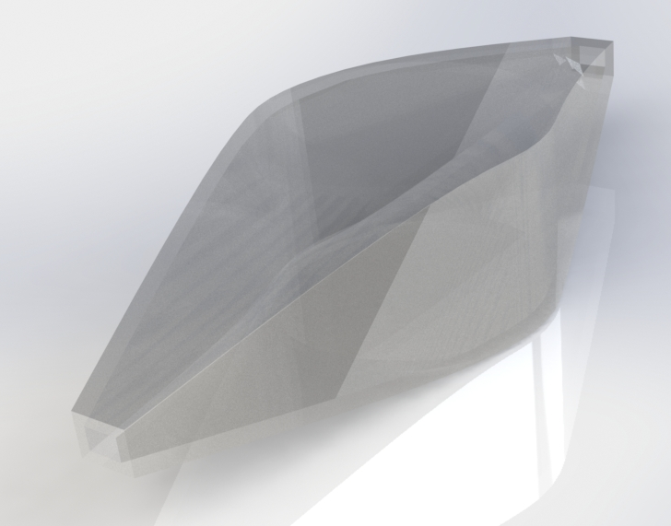
Outer PEN Shell
A 4-mm-thick, 33-cm-long hollow structure with 2 functionalities:
1- Surrounds the electronics tightly with inner PEN shell. This way it can catch more secondaries (β⁻s) from bkg events in electronic parts, scintillate and veto. Provides a cut on background induced by electronics.
2- Works as a light guide by reflection. Photons will bounce between the walls and be concentrated to a smaller area. This increases photon detection efficiency and, naturally, the veto efficiency.

Slide 7
SiPM Readout Array
2 arrays of several SiPMs are placed at both ends of the outer PEN shell.
Only take an event when more than 1 SiPMs get a signal to reject dark signal.
SiPMs and wires only have little mass and they are relatively far away from the detector, so the background induced by them won’t be much. Besides, PEN around them can also provide active veto.

Slide 8
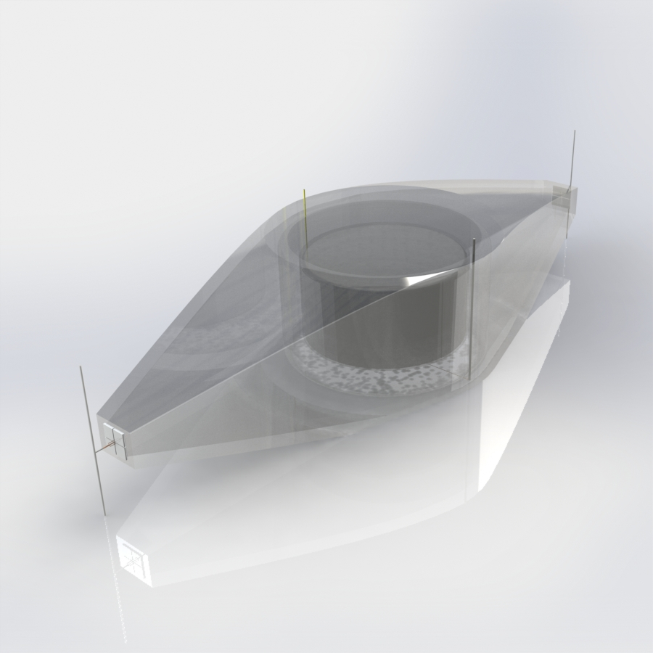
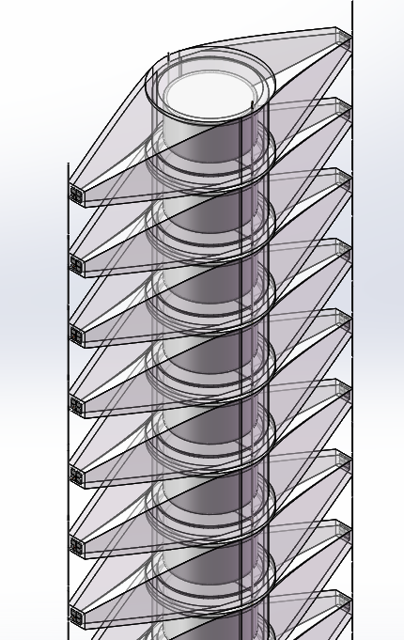
Unit and String

Slide 9
SAr Unit
A PEN made container with solid argon inside.
No underground argon is needed in this design. The nucleus in sAr are fixed so they won’t go near the detectors. As time goes by, background sources will die off in the container.
Even if there are background sources, they can be easily cut off by active veto. A major background source in sAr is K42 that can contribute to ROI. K42 emits a electron first, which can easily cause scintillation in Ar for veto.

Slide 10
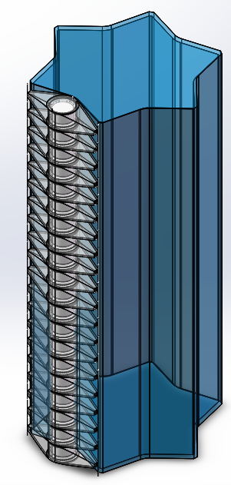
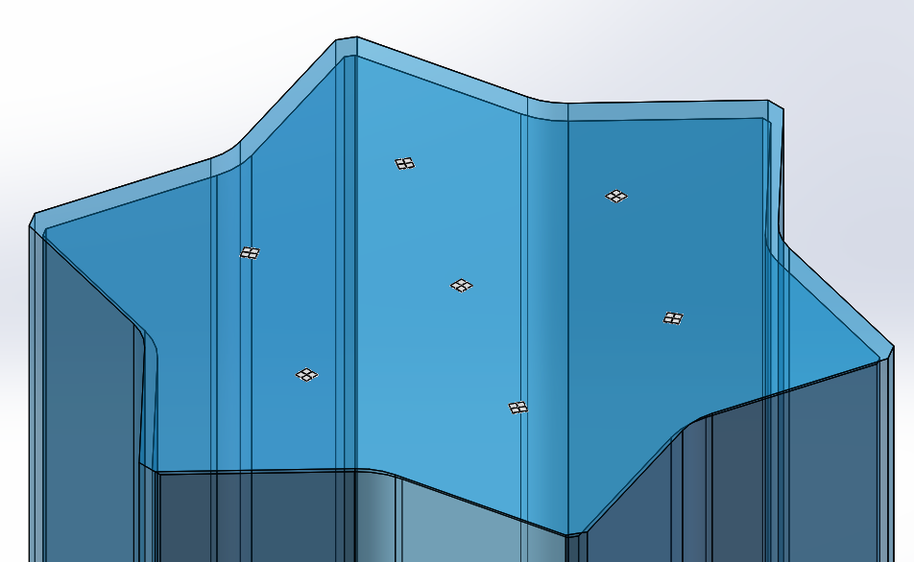
SAr Unit
Tube-like structure will guide the light and makes it easy to capture photons.
PMTs are placed at both ends of the container. Before photons reach them, their wave lengths are shifted in PEN and this ensures a high quantum efficiency.
Detectors are placed in the groove. Each tip of the hexagon is 3 strings of SiPM array wires. Simple geometry makes it easy to handle.
Thin layer of PEN around the detectors won’t get a good efficiency for gammas. But with ~50 cm of argon for each detector, we can now get a good detecting efficiency.

Slide 11
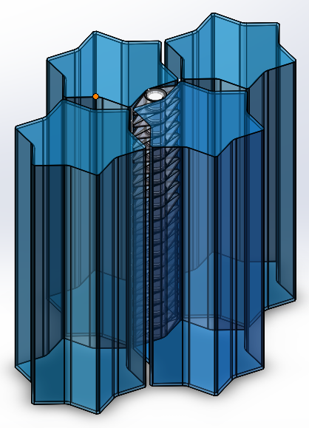
Modularized Ge-PEN-sAr System
Modular design: The whole system is fully modularized. Each part has its own functionality and can be commissioned separately.
Expandability: The design works for arrays of every size. No extra design is needed for larger scale. All we need to do is piling everything up!
Low background: Previous simulations have shown that with proper light readout the self-veto system can be as high as nearly 100%. It is safe tp say can get extra background cut by active veto at a cost of little budget.

Slide 12
Next…
Simulations: Various of preliminary simulations have been done with Geant4 and we have got some useful results. Simulations on this exact setup is on the way. Soon we will get our first results.
PEN: We have sighed a contract with the factory which produced scintillators for Daya Bay experiment. They have received raw PEN material and started testing. We should have first batch of our own PEN parts by the end of December.
Solid Argon: Solid argon fabrication is being developed in Sichuan University. And we have already got large, transparent argon crystal. After PEN production procedure is stabilized, we will try to build the sAr unit.

